Slide 1
Building the ideal Restaurant in Bangalore
Probability and Statistics 2 (Final Project)
TEAM MEMBERS
Aryan Jain
Mallory Sico

Slide 2

Problem Motivation (A short story)
I have money and I want to open a restaurant in Bangalore

Slide 3

Problem Motivation (A short story)
Let me ask these people
Let me look at most popular area and then select the best rated configurations
Let me look at best rated area and then select the most popular configurations
People who did not take Probability and Statistics 2

Slide 4
Problem Motivation (A short story)
Ok that seems great. Let me know your answers

Slide 5
Problem Motivation (A short story)
Well, what are the ideal restaurants?
Location: BTM
Cuisine: Asian, Chinese, Thai, Momos
Type: Buffet
Price Range: $$$$
Location: Church Street
Cuisine: North Indian
Type: Delivery
Price Range: $$
People who did not Probability and Statistics 2

Slide 6
Problem Motivation (A short story)
I don’t trust them completely, let me check in with some Data Scientists

Slide 7


Problem Motivation (A short story)
Do you guys think their approach is right, have they accounted for everything?
NO
What she said
People who took Probability and Statistics 2

Slide 8
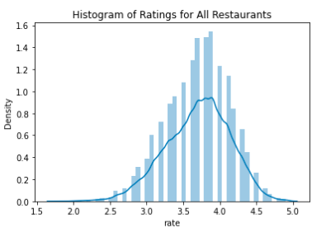
Data Exploration and Success Metric Determination
We first wanted to consider something that is a mix of number of votes and rating as a success metric for a restaurant. However, upon exploration of the data, the distribution of votes was heavily skewed so we went ahead with just ratings, which is distributed as shown:
We also find that approx cost is a big factor in the success of a rated which makes sense as expensive restaurants tend to be rated higher.
We find the 90 percentile rating to be 4.2 that we take as a “threshold for success” throughout the project.

Slide 9
Finding the ideal configuration
We divide the problem into two different pieces and try to solve each of them
Restaurant Type x Cost
Location x Cuisine

Slide 10
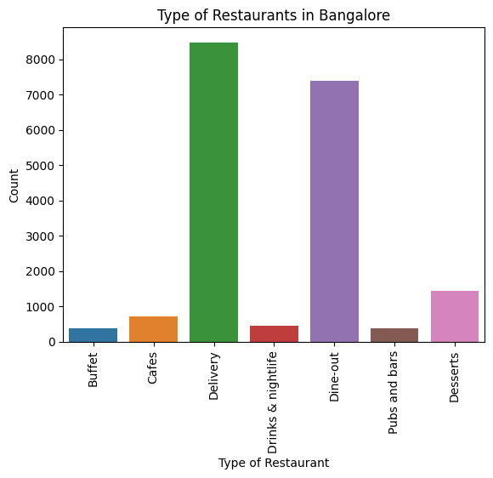
Restaurant Type x Cost for Two
Let us first look at how the restaurant types are distributed
We see that Delivery and Dine-Out dominate as these are more broader categories when compared to others. Among the more specific categories, we see that Bangalore has a considerable amount of "Dessert" restaurants. It is important to note that a restaurant listed as "Cafe" would also fall under "Dine-Out" (and possibly "Delivery"). Additionally, we also have restaurants that are more generic that would just be listed as "Dine-Out".

Slide 11
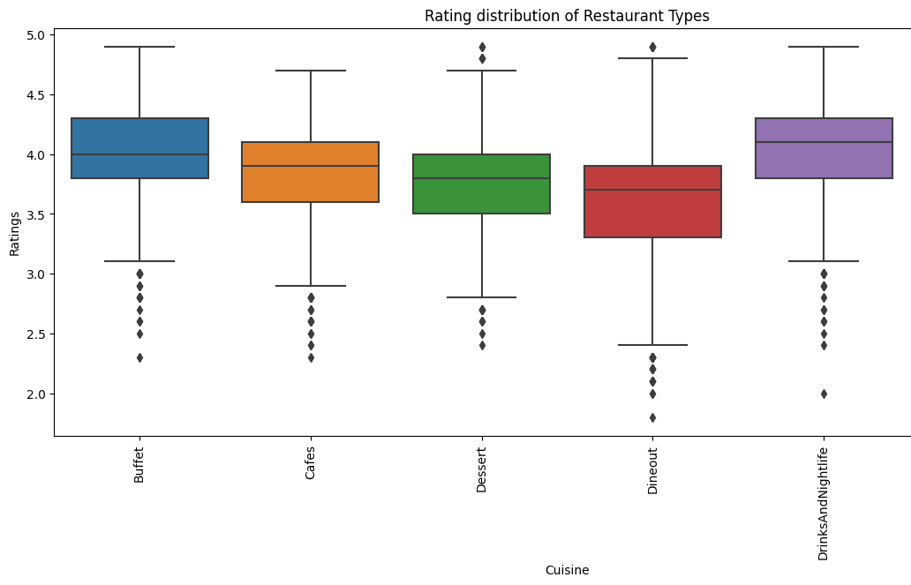
Restaurant Type x Cost for Two
We look at the rating distribution of the types to get a better understanding of the data
Drinks & Nightlife and Buffets are generally rated higher than other restaurant types.
Even though Desserts are a common restaurant type they do not fare as well with the population.

Slide 12

Restaurant Type x Cost for Two
Between the 2 top rated restaurant types (Drinks & Nightlife Buffets), we would like to choose one. For this we look at any potential confounders that could be there that could be bringing upon these higher ratings and can they be accounted for.
We will compare Buffets and Drinks & Nightlife using potential outcomes.
We identify Simpson's Paradox where we see that after adjusting for the confunder (cost for two), we see that buffets would be a better rated restaurant overall category. If we are setting up a expensive restaurant, we would go with Drinks & Nightlife.
If opening an expensive restaurant, go with Drinks and Nightlife.
If not, go with Buffets.

Slide 13
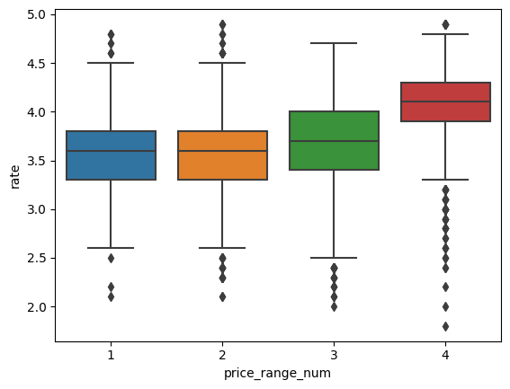
Restaurant Type x Cost for Two
Which exact price bucket should we go with?
We see that $$$ and $$$$ are more successful in terms of ratings when compared to $ and $$ restaurants. This is not to say that those restaurants should not be opened, it is just that their success metric is most likely different than the one we assume throughout this project
If you are opening a restaurant in the $$$$ price range, go with Drinks & Nightlife
If you are opening a restaurant in the $$$ price range, go with Buffets
Notes:
We see that getting to a very high rating is much harder for lower budget restaurants. This however does not mean that those restaurants would not be successful, but in our framework where success is a proxy for ratings it would not be in our interests to go with them.

Slide 14
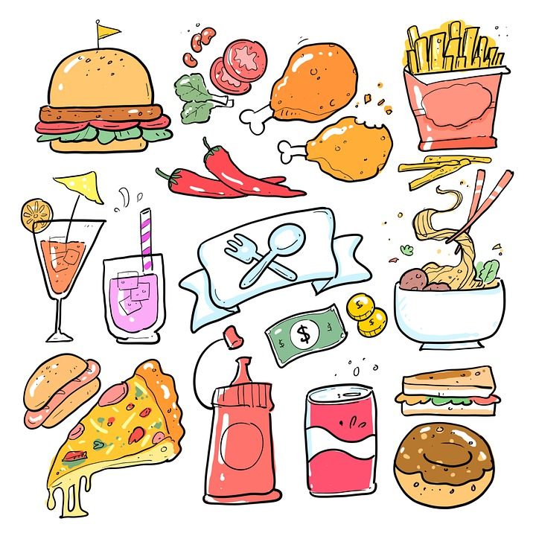
What if we want to open a generic Dine out restaurant?
Let us say that one does not want to open either of those restaurants. You seem to think that Buffets are not profitable or Drinks & Nightlife does not align with your philosophy of a restaurant, then what?
We also highlighted the fact before that the 5 types were just niches and a whole array of restaurants fell under 'Dining' and consequently 'Delivery'.
Looking at both these aspects, we now look forward to answering the cuisine question. This along with knowledge about the location will help us appeal to a broader audience looking to open restaurants in Bangalore under a more generic Dining umbrella.

Slide 15
Restaurant Cuisine x Location
We look at the top 5 most popular locations in Bangalore and try to decide the best cuisines for that. (For any specific location, the process can be repeated).
We look at the top 10 most popular cuisines as once we get to a location level, the count of restaurants of a specific cuisine severely decrease. So the top 10 are the only ones that would have some significance at this level.
For these cuisines, we look at two graphs:
A box plot of their rating distribution along with a median rating line to show which cuisine is outperforming in that location.
A bar graph comparing the distribution of the cuisines in that specific location v/s the distribution of cuisines across Bangalore. This will help us get a supply demand perspective into the problem.

Slide 16
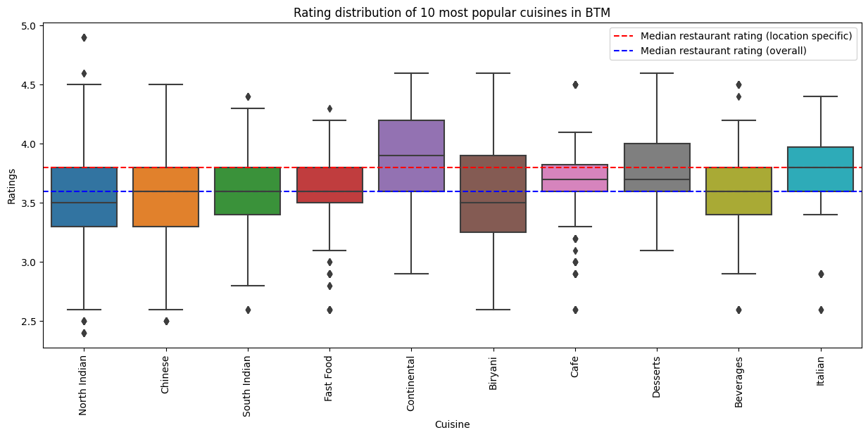
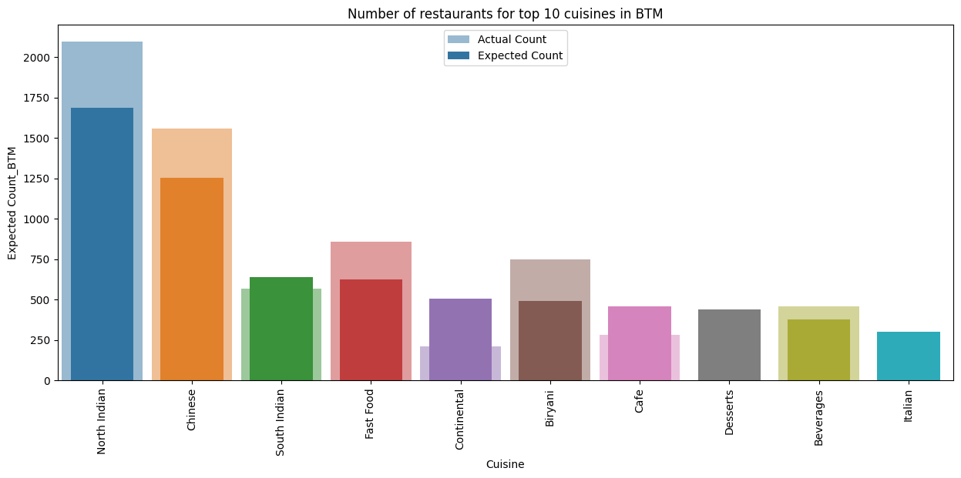
Restaurant Cuisine x Location

Slide 17
Restaurant Cuisine x Location
We make inferences like such for BTM (we do this for all the 5 locations):
The people of this area generally rate the same as the rest of Bangalore.
We see that the top 2 highest rated restaurants in the area are North Indian (However, North Indian overall is not rated too special)
Italian restaurants seem to have less variability so would make for a strong contender as well. However, we see that this is due to the fact that there are very few Italian restaurants in the area (so much so, that they don't even show up significantly in the graph).
Continental restaurants seem to be our best answer here as they are rated the best and also have much fewer restaurants than expected, so we can see that the market is not saturated.
BTM: Continental Cuisine
Koramangala: North Indian Cuisine
HSR: Cafe
Indiranagar: Explore outside top 10 cuisines
JP Nagar: Chinese Cuisine

Slide 18
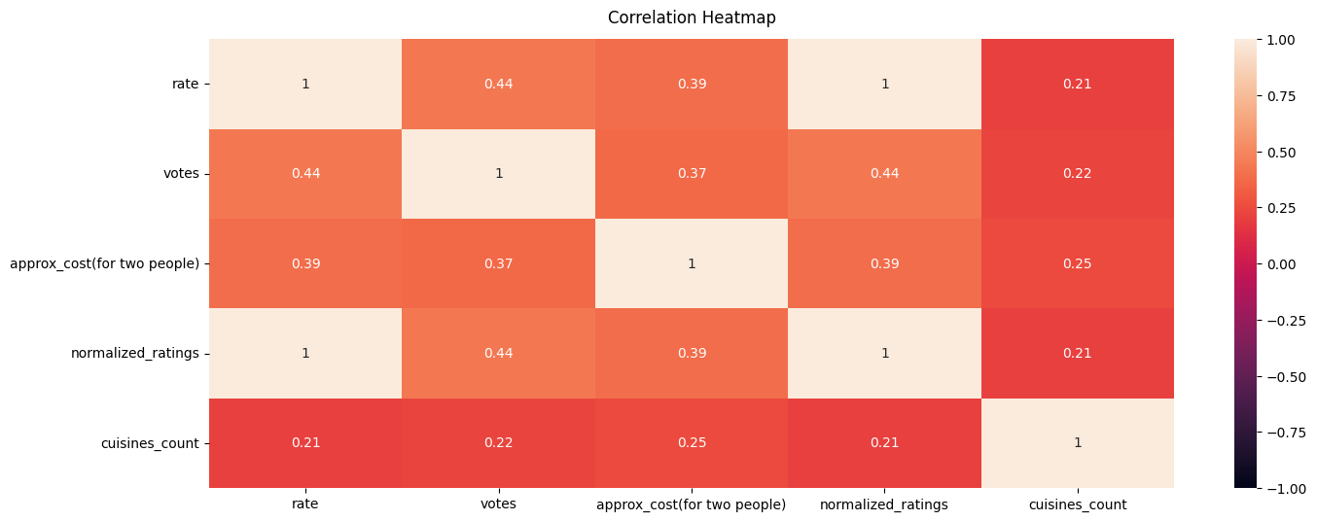
Additional Inferences
There is a high correlation between ratings and votes. The number of votes is not in our control as that depends on the success of the restaurant as well as how long the the restaurant has been running. However, this tells us that when starting the restaurant we should incentivize voting at our restaurant.
Start schemes like "If you rate us on Zomato, we will give you a free dessert".

Slide 19

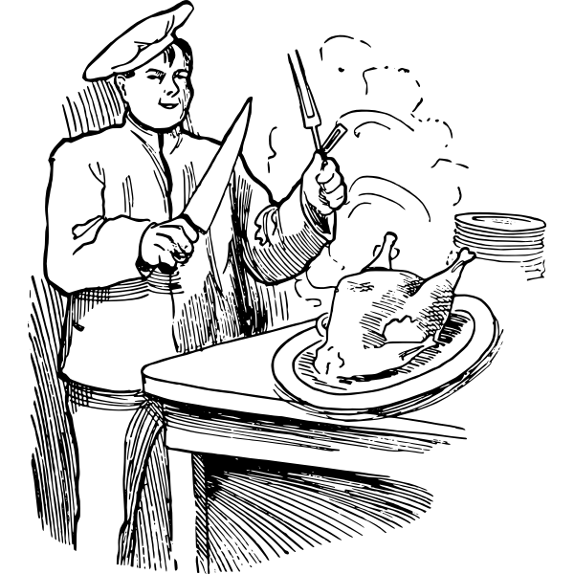
What Next?
We saw how important cost was before through the KDE plot. However, it is certainly an important parameter, but not all that is important. We saw that 50% of $$$$ restaurants don't outperform the 90 percentile mark. In fact, 25% of those restaurants lie below the median rating in Bangalore. This tells us that there are certainly other factors that make the ideal restaurant. So this brings the question, what are these factors (other than those we already described)?
To answer this question, we will look at the reviews in the next phase to identify things that matter the most to a consumer in Bangalore (especially in the realms of our ideal restaurant). This could highlight things like service and taste to show us what we should invest in the most.

Slide 20
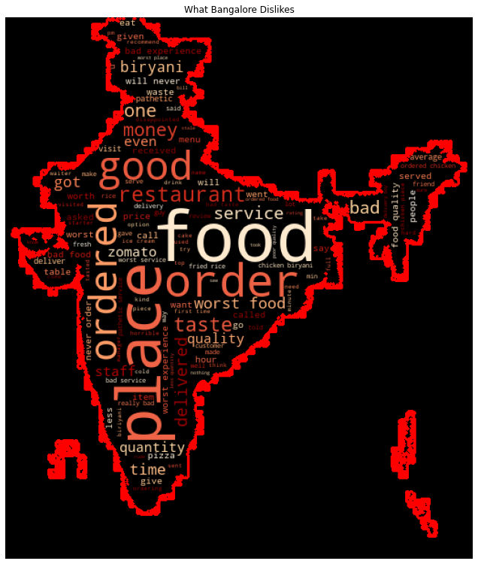
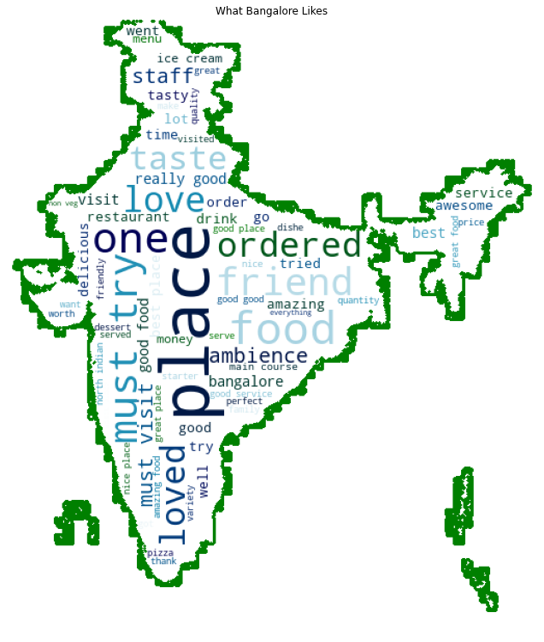
Feature Engineering using Reviews
We try to see what specific words pop up in 1-star and 5-star reviews

Slide 21
Feature Engineering using Reviews
From the word clouds above we can now pick the most common words under different categories. Based on the counts of these words on the reviews, we can get an estimate of what is important to people in Bangalore.
Based on domain knowledge and the wordcloud, we decide on having 5 categories: Service, Vibe, Group, Taste, Worth for Money
Service: staff, service, friendly, good service
Vibe: vibe, ambience, ambiance
Group: friend, friends
Taste: tasty, taste, great food, good food, delicious
Value: money, worth
Formula used = (Count of word in all reviews of restaurant)/(Number of reviews of restaurant). Range is from 0 to 1 (both inclusive).
In this domain, we assume that all 5 stars reviews are positive. To correct for this assumption we used VADER to get sentiment scores of all reviews and also verify our results at all steps using only reviews that have a positive sentiment score >0.9.

Slide 22
Feature Engineering using Reviews
To identify which among the 5 is most important, we build a linear regression model with the target variable as ratings. The feature coefficients so obtained would tell us which feature is the most important.
Since we detected multicollinearity among the 5 categories, we use Ridge Regression instead of OLS as it is able to correct for that multicollinearity.
The feature importances obtained from the model are:
Vibe: 0.329220
Service: 0.080638
Value for money: 0.014240
Good for Groups: 0.0045469
Taste: 0.0083985
Offer great ambience to the customer, followed by great service.

Slide 23
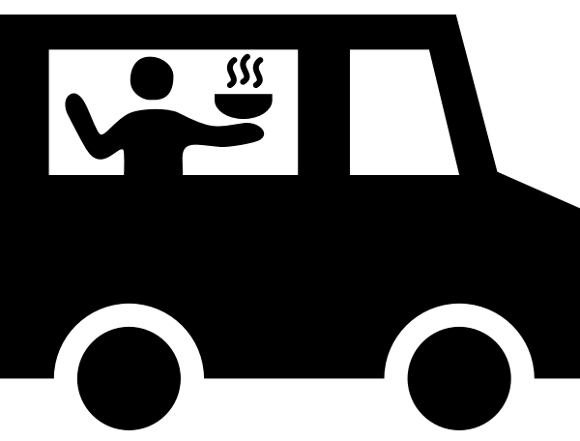
Feature Engineering using Reviews
When we extract 1 star reviews mentioning delivery, we see a very interesting insight. The correlation between ratio of 1 star delivery reviews to the rating of the restaurant is -0.19. This is the biggest feature in 1 star reviews.
This is something that is generally not in the hands of the restaurant and more often than not is a fault of Zomato (the delivery partner).
Ensure that you have great packaging and
you do not deliver very far (This would lead to the food being served cold).

Slide 24
ML Modeling: Initial Test
To verify our ideal restaurants, we look to pass them as “test-data” into a Machine Learning model.
Catboost provided the best model showing 12% improvement over logistic regression baseline, but still having f1-score below 0.5 for overall data.
We saw earlier that price was a confounding variable. When only looking at restaurants in the $$$$ price range, the model performs best (f1-score = 0.83). Using this model to predict our ideal configurations, both of the following configurations are predicted to be in the top 90th percentile.
Location: BTM Cuisine: Continental Price Range: $$$$ | Location: Koramangala 5th Block Cuisine: North Indian Price Range: $$$$

Slide 25

The Big Test (Real Life Data)
Since, this dataset was made in 2017, it is close to 6 years old. Since then new restaurants did open and some in the configurations we predicted. Here is how they performed:
Continental Restaurants in BTM:
(K-OS Game Bar: 4.5, Fogg Lounge: 4.4, Mudpipe Cafe: 4.2).
North Indian restaurants in Koramangala:
(Kathpals: 4.3, Jalandhar Street: 4.0)
Cafes in HSR:
(Hustle: 4.9, Burger Yard: 4.8, Cuppa Redefined: 4.5)
2 of the cities highest rated restaurants are now cafes in HSR.
Buffets in $$, $$$ price range:
(Kitchen De Buffet: 4.7, Maxims Buffet: 4.2, One Atria Cafe: 4.3, Zodiac: 4.0, The Buffet Table: 3.5).

Slide 26
Thank You
Project made possible under the guidance of:
Prof. Carlos Fernandez-Granda

